Slide 1
CROSS-BORDER INVESTMENT ENVIRONMENT
Dr. Kwangsoo Kim
Konkuk University

Slide 2
AGENDA
Concept and Trend of FDI
Theory of FDI
Political Economy of FDI
Implications for Businesses

Slide 3
Concept and Trend of FDI

Slide 4
Concept of FDI
FDI (Foreign Direct Investment) occurs when a firm invests directly in assets in a foreign country for management and control purposes.
FDI includes buying shares of an enterprise in another country, reinvesting earnings of a foreign-owned enterprise in the country where it is located, and parent firms extending loans to their foreign affiliates.
IMF guidelines: Foreign investment that accounts for at least 10 percent of the foreign firm's voting stock of shares. (http://www.worldbank.org/depweb/english/beyond/global/glossary. Html)
MNC/MNE: A firm that engages in FDI.
FPI (Foreign portfolio investment): Foreign investment with no managerial involvement

Slide 5
Concept of FDI
FDI Flow (FDI outflows/inflows): The amount of FDI undertaken over a period of time
FDI Stock:
The total accumulated value of FDI at a given time
Horizontal FDI:
FDI in the same value-chain activities
Vertical FDI:
FDI in upstream or downstream value-chain activities

Slide 6
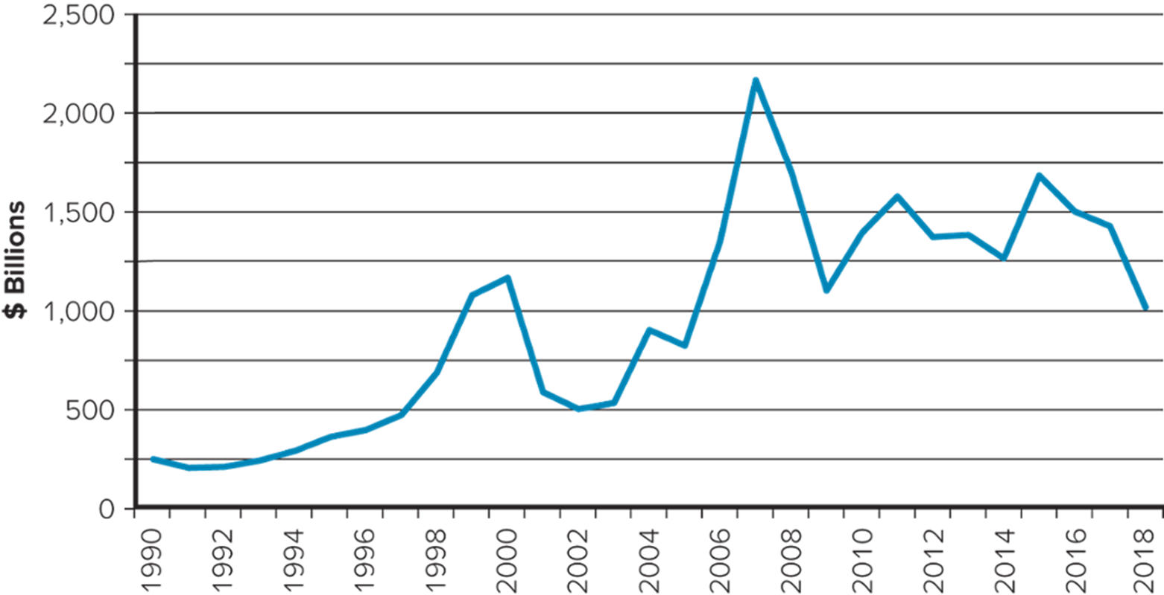
Trend of FDI: Outflows

Slide 7
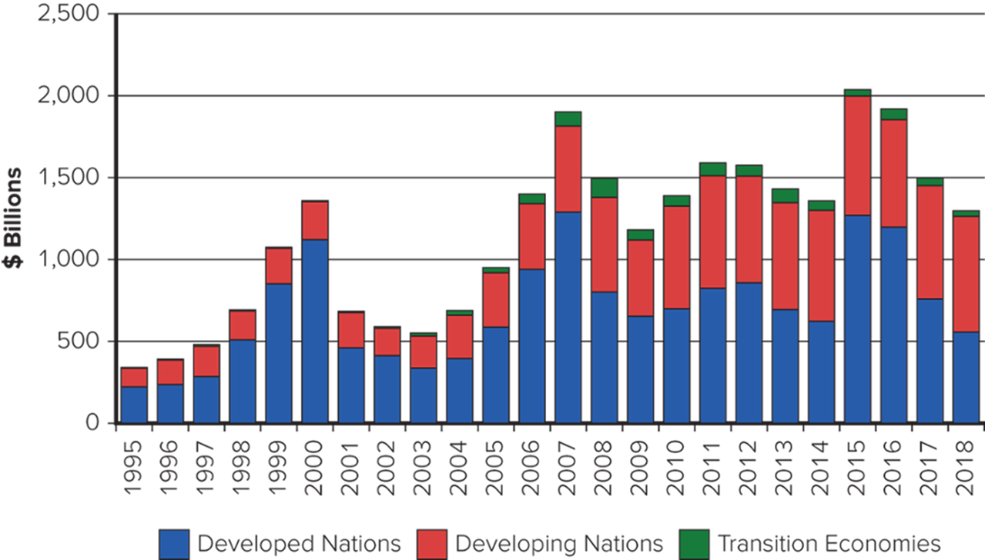
Trend of FDI: Inflows by Region

Slide 8
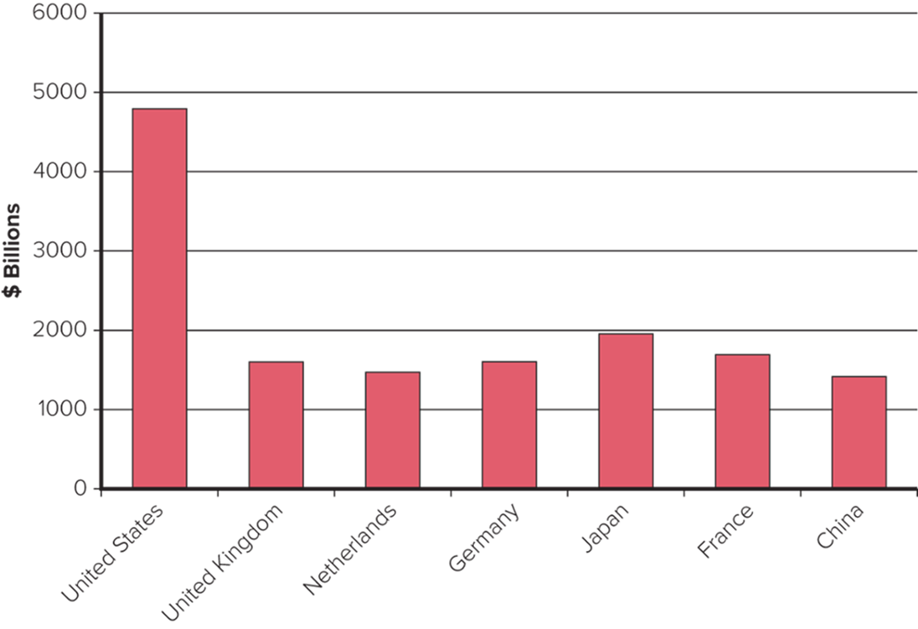
Cumulative FDI Outflows (1999-2019)

Slide 9
Theory of FDI

Slide 10
Slide 6-7
Internalization Theory
FDI over exporting
- High transportation costs & trade barriers
FDI over licensing or franchising
- Need to retain strategic control over operations to maximize profitability
- Need to protect technological know-how
- Capabilities not suitable for licensing/franchising

Slide 11
Strategic Behavior Theory
FDI flows are a reflection of strategic rivalry between firms in the global marketplace
Firms tend to follow suit as their competitors make FDI.
This theory explains the relationship between FDI and rivalry in oligopolistic industries well

Slide 12
Product Life Cycle Theory
Firms undertake FDI at particular stages in the life cycle of a product they have pioneered.
Unit Sales
Introduction
Growth
Maturity
Decline

Slide 13
Eclectic Theory
Ownership advantage:
- Unique firm-specific advantage, including brand, technology,
economies of scale, management know-how, marketing, etc
Location advantage (target location):
- Land, labor, capital, know-how, host country policies, natural
resources, unique supplier characteristics
Internalization advantage:
- Transaction costs of an arms-length relationship higher than
managing the activity within the MNE’s boundaries

Slide 14
Motivation/Objectives of FDI
Resource-seeking FDI
- To seek and secure resources, e.g. minerals, raw materials, land and building costs,
- SK energy’s FDI in Peru for LNG (liquefied natural gas)
Market(End-Product)-seeking FDI
- To identify and exploit new markets for the firms’ finished products (Market size and per capita income, Market growth, Access to regional and global markets, Country specific consumer preferences, Structure of markets)
- Automotive MNEs have invested heavily in China

Slide 15
Motivation/Objectives of FDI
Efficiency-seeking FDI
- To seek efficiency or cost reduction through FDI
Asset-seeking FDI
- To seek strategic assets through FDI
- Acquisition of local capabilities, including R&D, knowledge and human capital, market knowledge; Physical infrastructure (ports, roads, power, telecommunications), etc.

Slide 16
FDI Decision Framework
How high are transportation costs and tariffs?
Low
Export
High
Is know-how amenable to licensing?
No
FDI
Yes
Is tight control over foreign operation required?
Yes
FDI
No
Can know-how be protected by licensing contract?
No
FDI
Yes
Then license

Slide 17
Political Economy of FDI

Slide 18
Political Ideology toward FDI
Ideology Characteristics Host-Government
Policy Implications
Radical
View
Marxist roots
Views the MNE as an
instrument of imperialist
domination
Prohibit FDI
Nationalize subsidiaries of
foreign-owned MNEs
Free
Market
Classical economic roots
Views the MNE as an
instrument for allocating
production to most efficient
locations
No restrictions on FDI
Pragmatic
Nationalism
Views FDI as having both
benefits and costs
Restrict FDI where costs
outweigh benefits
Bargain for greater benefits
and fewer costs
Aggressively court beneficial
FDI by offering incentives

Slide 19
Effects of FDI on Host Country
Benefits
- Resource transfer (technology, managerial skills, capital, etc.)
- Increased employment
- Beneficial effect on the balance-of-payments (BOP)
Import substitution; initial capital investment, etc
- Competition and economic growth
Costs
- Adverse effects on BOP
MNEs repatriation of profits and capital outflow;
Importation of production input
- Potential threat to domestic firms
- Threat to national sovereignty and autonomy
Loss of economic independence

Slide 20
Effects of FDI on Home Country
Benefits
- Improves BOP for inward flow of foreign earnings
- Positive employment effect from increased exports
- Repatriation of skills and know-how
- Frees up employees and resources for higher value activities
Costs
- Negative effect on BOP
Initial capital outflow; sell back to home market
- Loss of employment to overseas market

Slide 21
Policy Instruments toward FDI:
Encouraging Instruments:
- Tax incentives (Host)
- Low interest rates (Host)
- Stable government and stable policies (Host)
- Risk insurance (Home)
- Elimination of double taxation (Home)
Discouraging Instruments:
- Ownership restraints (Host)
- Performance requirements (Host)
- Limit capital outflows (Home)
- Manipulate tax code to encourage domestic investment (Home)
- Political restrictions on investing in certain countries (Home)

Slide 22
Bargaining Between MNEs and Host Governments
Like other business transactions, FDI involves bargaining between MNEs and host governments.
MNEs prefer the minimal intervention and the maximum incentives from host governments, while host governments prefer a certain level of control and a minimum level of incentives.
The actual terms and conditions of FDI will be determined by the relative bargaining power of these two parties.
Skills in negotiation are critical in the field of FDI as in other business transactions.

Slide 23
Agreements on FDI
Efforts to Reduce FDI disputes and Promote FDI:
By mid-1990s, bilateral investment treaties (more than 1,000) were made, mostly with developing countries, to safeguard the investment of nationals of advanced countries
Little progress was made by multilateral efforts until the Uruguay Round(1986-94) covering investment issues on top of trade issues.
In the Uruguay Round, provisions on Trade Related Investment Measures (TRIMS), which prohibit governments from intervening in foreign investment such as requiring local content, were made and placed in the jurisdiction of WTO.
- For the telecommunication industry, 69 countries reached an agreement in 1996 that included the rights of foreign firms to participate in their markets.

Slide 24
Implications for Businesses

Slide 25
Implications for Businesses
Evaluate carefully whether FDI is justified as an alternative to exporting and licensing/franchising
- Exporting is preferable to licensing and FDI as long as transportation costs are minor and tariff barriers are trivial.
- As transportation costs/tariff barriers increase, licensing is preferable to FDI, other things being equal, since FDI is more costly and risky than licensing.
- FDI works best when the following condition(s) exists:
A firm has valuable know-how that needs to be completely protected.
(e.g., high-tech companies)
A firm needs tight control over a foreign entity’s business operations.
(globally integrated companies like Toyota)
A firm’s know-how is highly tacit or embedded.
(tacit knowledge like Toyota production system)

Slide 26
Implications for Businesses
A host government’s attitude toward FDI is an important factor for FDI decisions.
Be aware of other world and national institutional factors (both constraints and facilitators) governing FDI and enhance legitimacy in host countries
Bargaining between MNEs and host governments becomes important for FDI. And the relative bargaining power of these two parties will determine the actual terms and conditions of FDI.
Firms are operating within the context of FDI, and they have room for influencing the context.
All these world and national institutions are likely to facilitate the free flows of FDI, which in turn will promote the phenomenon of globalization.

